Slide 2
UPeCe need YOU

Slide 4
UPeCe is accredited to:
Sending Organization- SO (SO may send a volunteer on EVS project abroad),
Hosting Organization- HO (UPeCe like HO is ready to accept volunteers from abroad and take care of him),
Coordinating Organization- CO (CO can write and receive a grant to secure volunteer EVS project in UPeCe or abroad, or coordinate other projects in other organizations).

Slide 5
Our accreditation number is:
2014-1-SK02-KA110-000122

Slide 7
What is EVS project?

Slide 8
What is EVS project?
The European Voluntary Service (EVS) enables young people to carry out voluntary service for up to 12 months in a country other than their country of residence.
An EVS project is a grant program which can focus on a variety of themes and areas, such as culture, youth, sports, social care, cultural heritage, arts, civil protection, environment, etc.

Slide 9
What is EVS project?
The European Voluntary Service (EVS) enables young people to carry out voluntary service for up to 12 months in a country other than their country of residence.
An EVS project is a grant program which can focus on a variety of themes and areas, such as culture, youth, sports, social care, cultural heritage, arts, civil protection, environment, etc.
EVS is a grant program Erasmus+. This program is managed by the EU.

Slide 10
Who can participant?

Slide 11
Who can participant?
Young people aged between 17 and 30, legally resident in the country of the Sending Organisation.

Slide 12
Who can participant?
Young people aged between 17 and 30, legally resident in the country of the Sending Organisation.
How long it may take EVS project?

Slide 13
Who can participant?
Young people aged between 17 and 30, legally resident in the country of the Sending Organisation.
How long it may take EVS project?
Usually, a minimum of 2 months and a maximum of 12 months. But for UPeCe we are looking someone for 12 months.

Slide 14
OK but What is UPeCe for young people?

Slide 15
OK but What is UPeCe for young people?
For young people from abroad is Hosting Organization.
For students from UPeCe is Sending Organization.
For other organization is Coordinating Organization

Slide 16
OK but What is UPeCe for young people?
For young people from abroad is Hosting Organization.
For students from UPeCe is Sending Organization.
For other organization is Coordinating Organization
Need I Sending Organization when I want to go to UPeCe on EVS project?

Slide 17
OK but What is UPeCe for young people?
For young people from abroad is Hosting Organization.
For students from UPeCe is Sending Organization.
For other organization is Coordinating Organization
Need I Sending Organization when I want to go to UPeCe on EVS project?
Yes. Your sending organization can be found in the database of accredited organization at: http://europa.eu/youth/evs_database.
But first, it is good to find Hosting Organization like UPeCe is.

Slide 18
What offers me UPeCe?

Slide 19
What offers me UPeCe?

Slide 20
You can choose which team you want to cooperate. The choice is up to you. We have 22 teams.

Slide 21
Motion:
1.Sport team,
2.Hiking team (Tupci),
3.Scout team,
Skills:
4.Gastronomic team, 5.Decoration team, 6.Technician team, 7.Computer team,
8.Web team,
Culture:
9.Theatrical team (Theatre Christoffer),
10.Music and singer team,
Intellect:
11.Marketing team (Promo),
12.EVS team (volunteering),
13.Grant team (Granko), 14.Library team,
Community :
15.Animation Team,
16.The children's catechesis Team (DeKa),
17.Missionary Team,
18.Tutors Team,
19.Adoration team,
20.Prayer team,
21.Praise team,
22.Liturgical team (Acolytes and Sacristans)

Slide 22
Waw! It looks great.

Slide 23
Waw! It looks great.
What should I do so that I belonged to UPeCe.

Slide 24
Waw! It looks great.
What should I do so that I belonged to UPeCe.
Just send your CV and motivation letter to:
upece.eds@gmail.com

Slide 25
We will provide you: accommodation, food, Slovak lesson, volunteer activities, pocked money 95€ and part of the money for transportation to Bratislava.

Slide 26
We will provide you: accommodation, food, Slovak lesson, volunteer activities, pocked money 95€ and part of the money for transportation to Bratislava.
Do not forget! You must send your CV and
motivation letter to 30 June 2014. And then...

Slide 27
We will provide you: accommodation, food, Slovak lesson, volunteer activities, pocked money 95€ and part of the money for transportation to Bratislava.
Do not forget! You must send your CV and
motivation letter to 30 June 2014. And then...
...you can come to UPeCe between
August 1, 2014 to 28.February 2015
...be with us one year... And then...

Slide 28
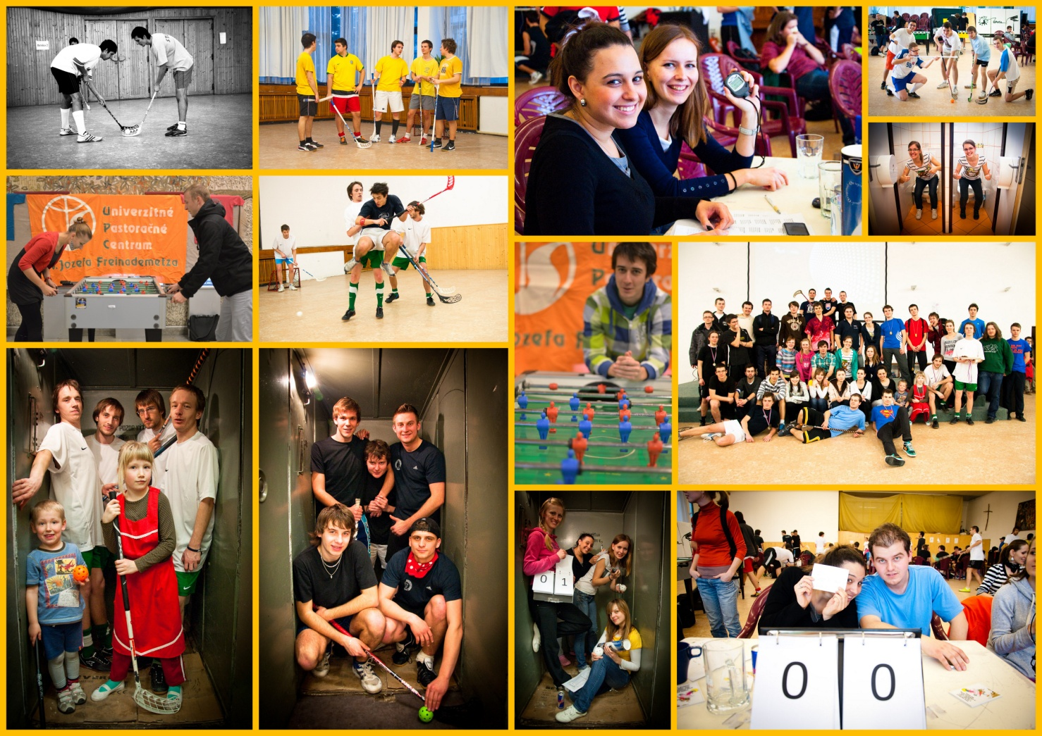
...you can enjoy:
Sports

Slide 29
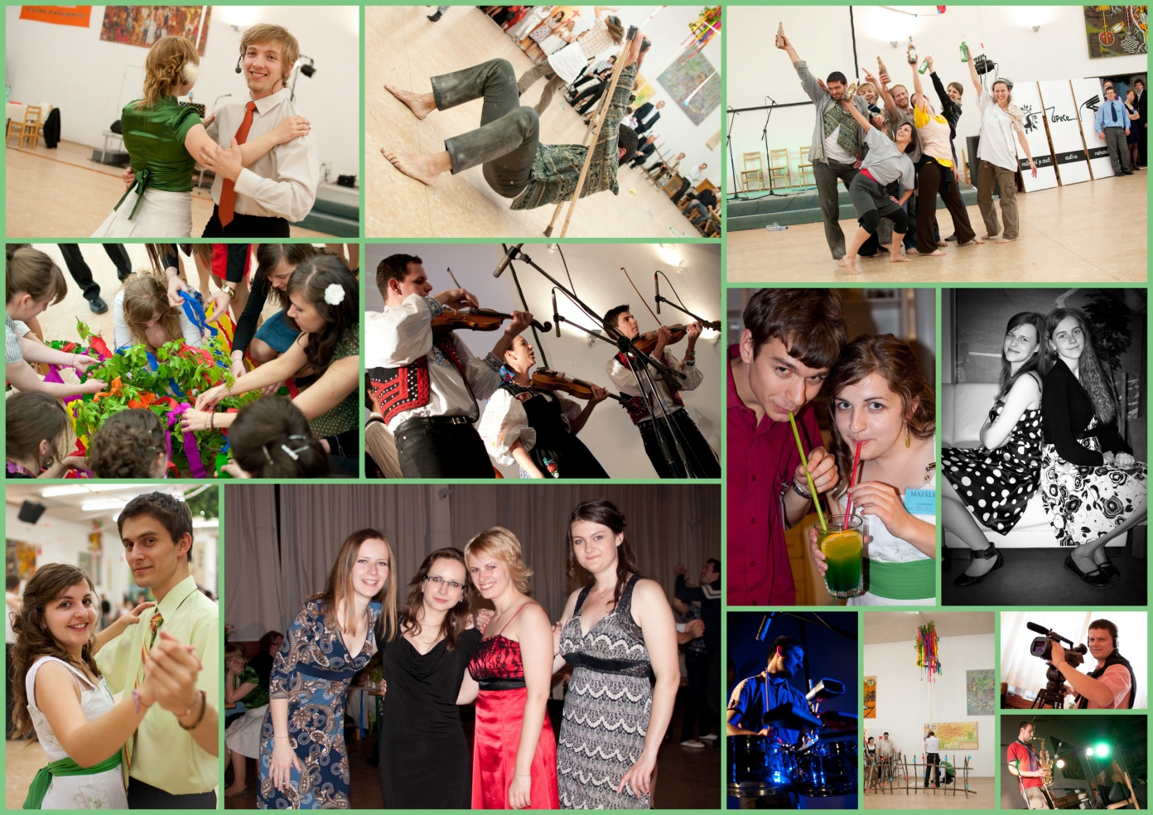
Majáles

Slide 30
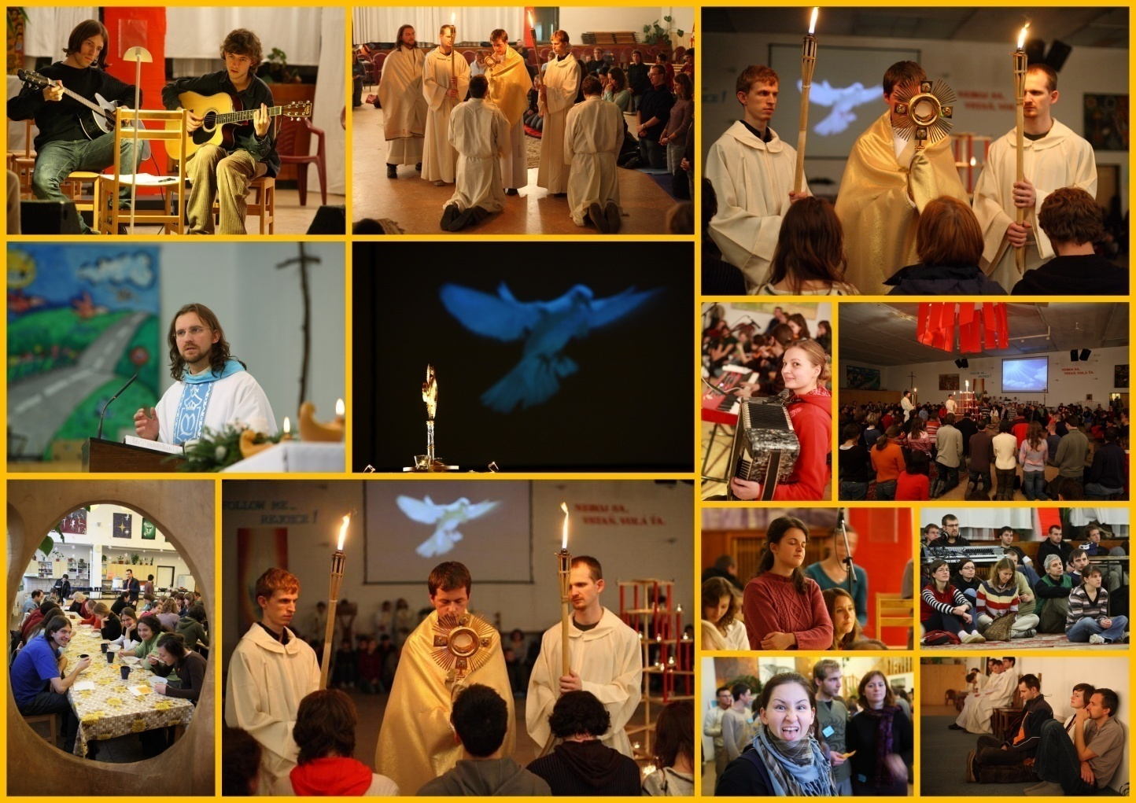
Adoration

Slide 31
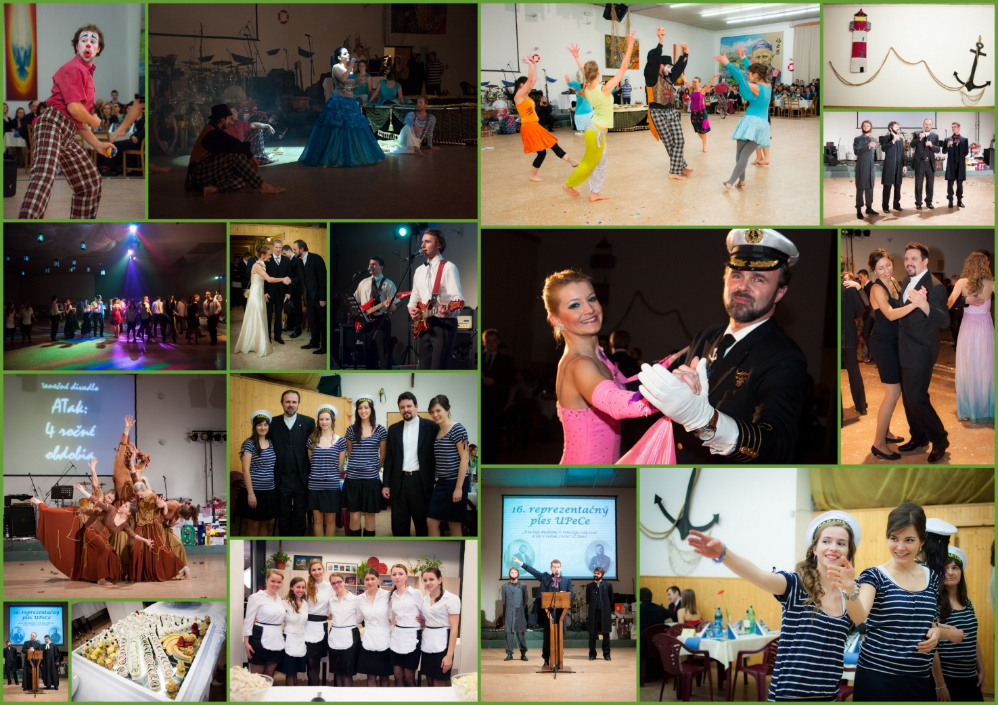
Balls

Slide 32
Slovak folk fun

Slide 33
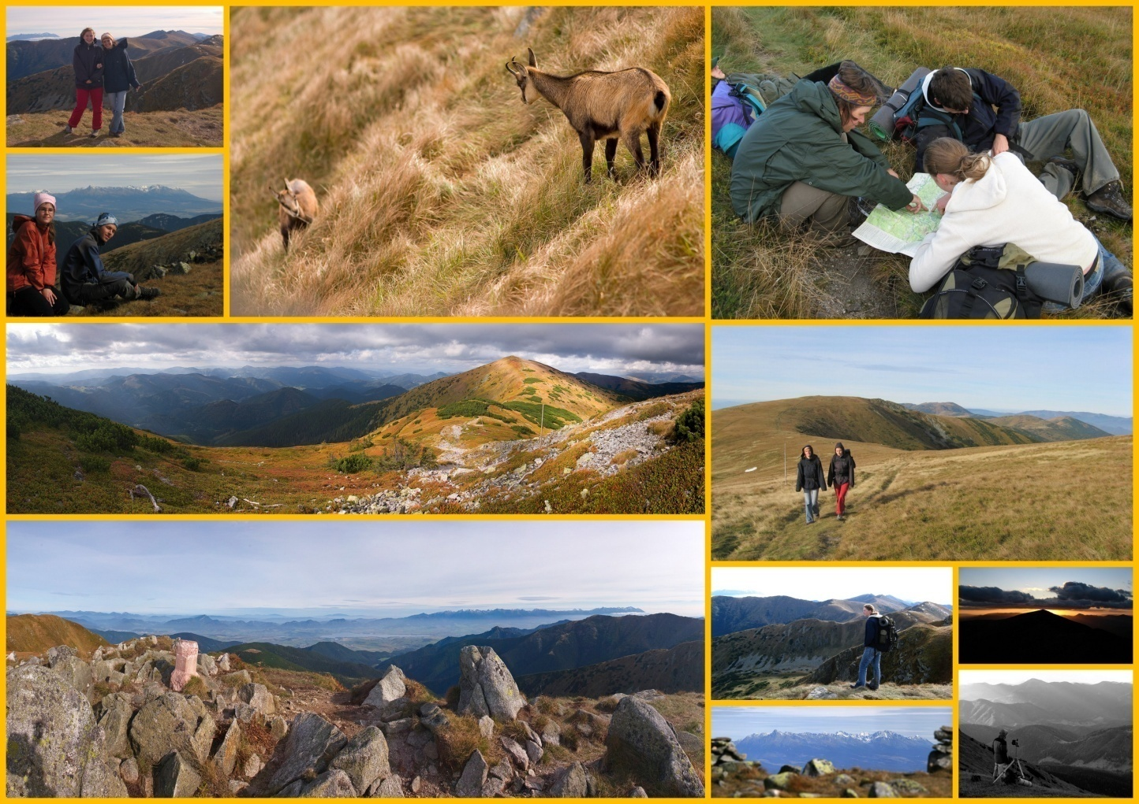
Hiking

Slide 34
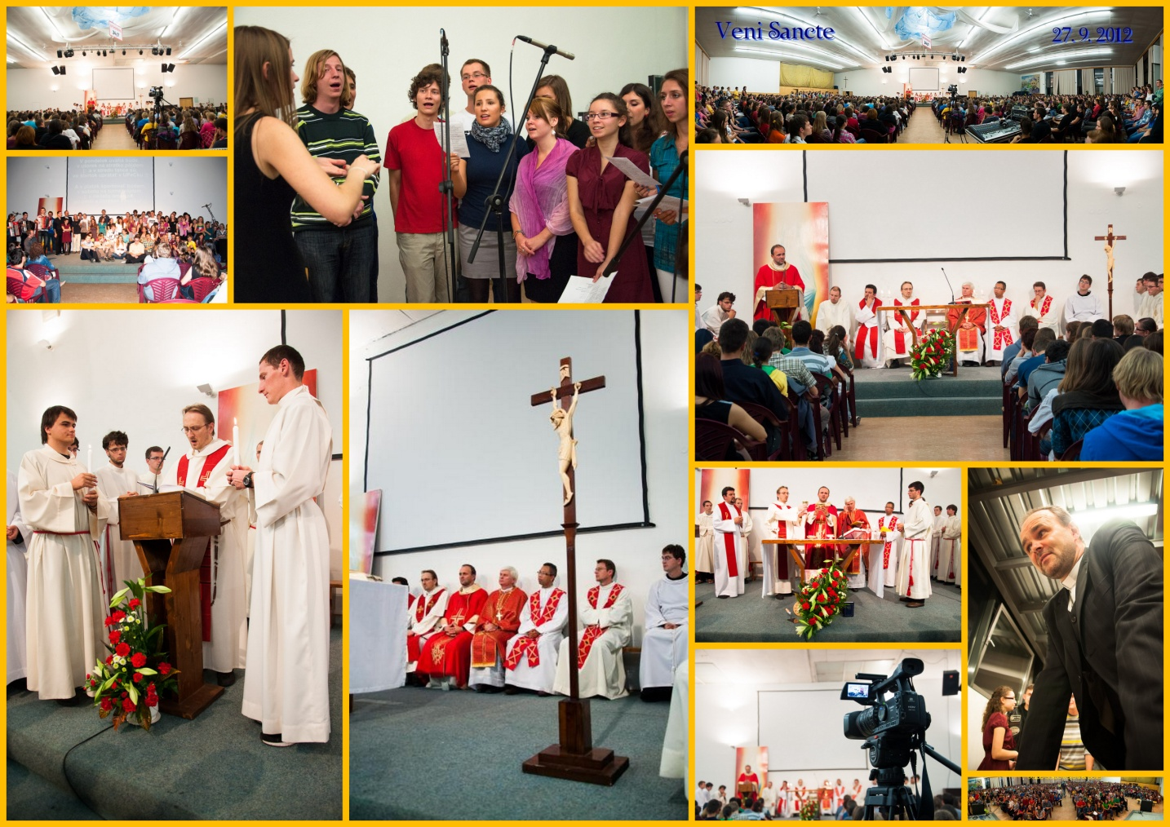
Veni Sancte

Slide 35
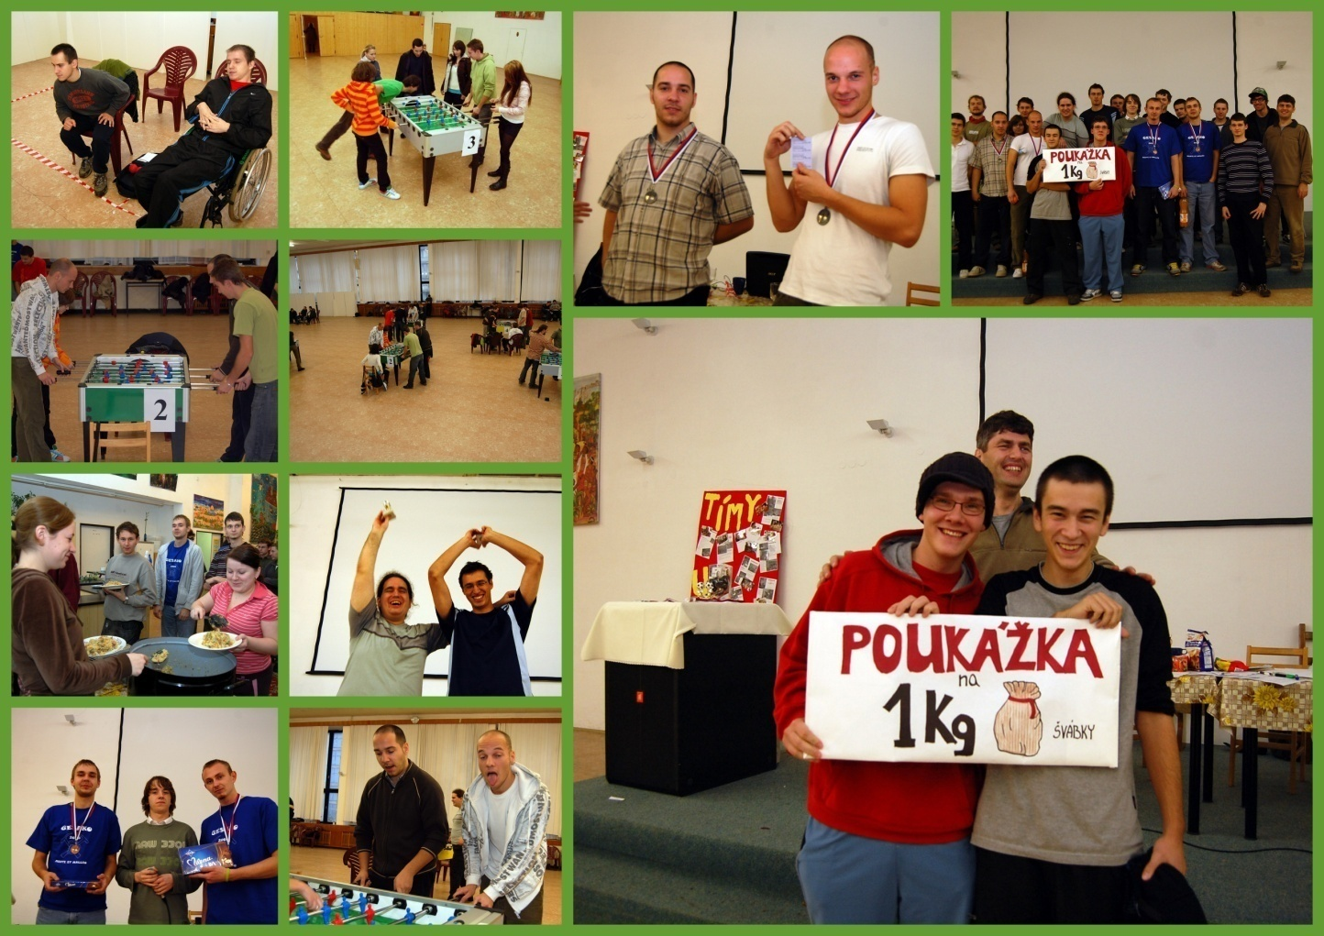
Tournaments

Slide 36
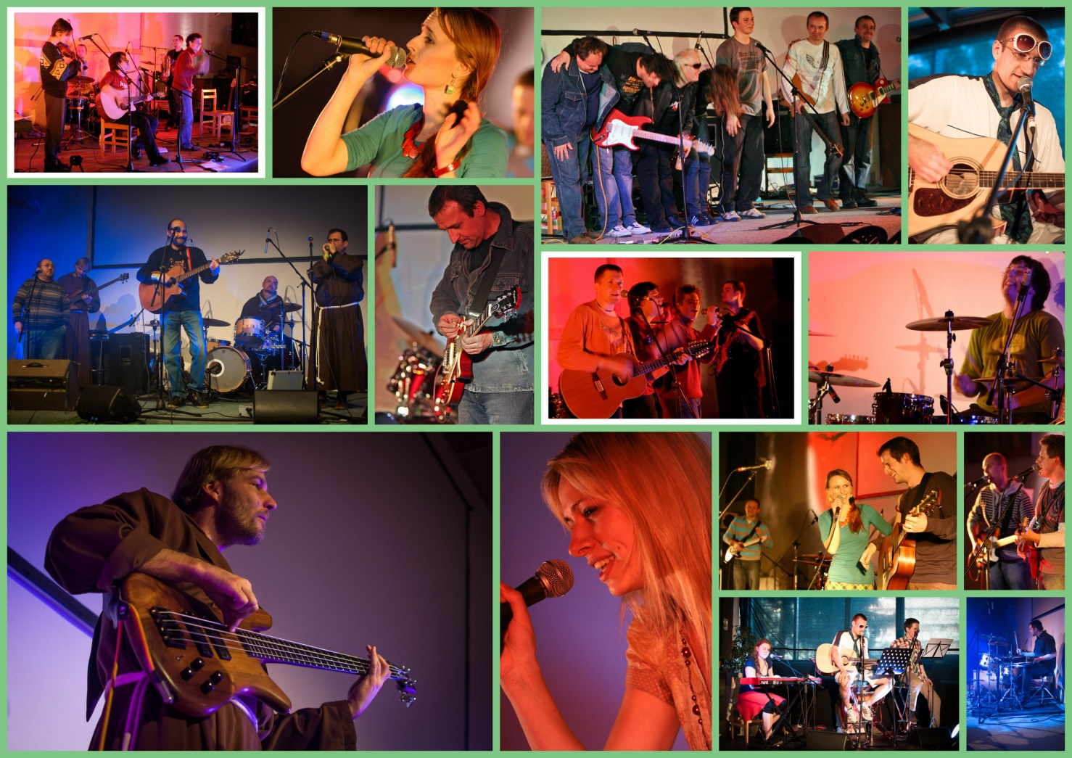
Concerts

Slide 37
... And much more

